Slide 1

What are your users doing?
A plugin to detect their behavior on your web site.
Notes:
Due to the time differences, our partners in China who worked directly with Yemol are unfortunately unable to make it and so I’m assisting them by presenting on their behalf. I’m actually not a member of the team. The idea behind the project is to develop/utilize a plugin to so that we can answer the question of “What are our users doing?”

Slide 2
In order to provide a better user experience we have to know how our customers are using
our site…
What is the best way to achieve this?
Standing behind him/her to see what are they doing?
Notes:
Why is what our users do important? One of the challenges to providing a great UX experience of a product is knowing how they use it. But what is the best way to go about doing this? Do we guess what they would try to do? Design it in a way that makes sense to us? Or do we go to each location and observe how they use the product?

Slide 3
NO
Notes:
While those are all good ideas and the last one is definitely effective, it’s probably not the best. So, how can we go about capturing their behavior w/ out intruding on them?

Slide 4
We can use a plugin to detect and record all user actions on page and save this data into our database. And then, our system can tell you more about the end-to-end experience of clients accessing our sites.
Notes:
Well we can do that by either utilizing or developing a browser plugin that monitors what they do. And then we can collect all that data, store it in a dB, and then analyze the data to learn more about the end-to-end user experience of our clients.

Slide 5
How it works
Database
Query
Query
Processor
Report
Detector
Listener
BI Analysis
Notes:
So how does it work? Well on each page we’d have both a detector and listener running the background (and I’ll get into what those are in the next few slides). Once something of interest is detected, it would ultimately get saved to a dB. And then from the dB, we can look at the data in a raw form or feed it to a Business Intelligence system to process it before generating a report.

Slide 6
What is the detector?
Detector is a JavaScript file. Once you load this file in our site, all user action in the site will be posted, using JSON format, to listener to be saved.
Here are some examples of actions we can track:
Focusing on an element
Lost focus on an element
Typing in an element
Navigating to another page by clicking an element
Notes:
It’s nothing more than JS file that is loaded with each page. Once it’s loaded it detects actions of interest, packages it up into a format known JSON (or JavaScript Object Notation), and then sends it off to a Listener.

Slide 7
What is the listener?
Listener is just a simple page or web service to receive post JSON string and save it into the database.
Notes:
Listener is a simply web page or service that runs in the background waiting for the detector to feed it data. Once the listener receives data it sends it off to get saved to a dB.

Slide 8
What customer can do with it?
Through this plugin site admin can see following information real time:
How many visitors on the site
The navigation path of each visitor on the site
What actions they performed while visiting the site
Notes:
And all this information is provided in real time.

Slide 9
What we can do with this information?
We can reproduce all user actions on our site.
We can see how long each user stays on a page
We can track common user patterns
Extract information on overall user experience

Slide 10
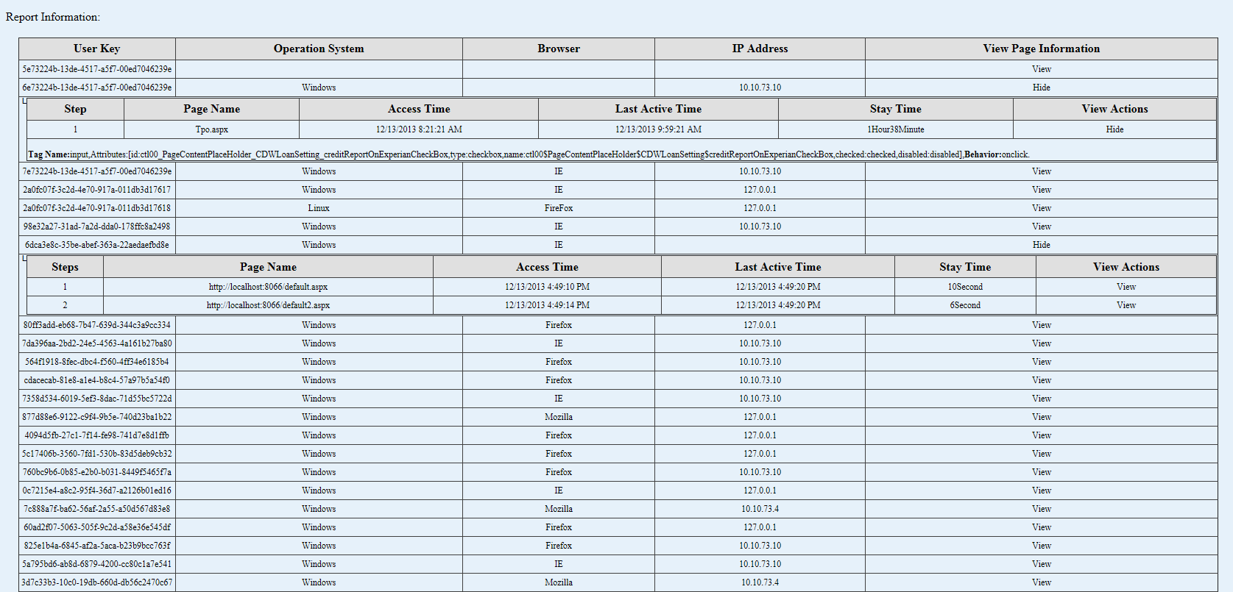
Demo our prototype

Slide 11
Thank you
More data = more possibilities!
Notes:
More data provides us with more possibilities.

